Slide 1
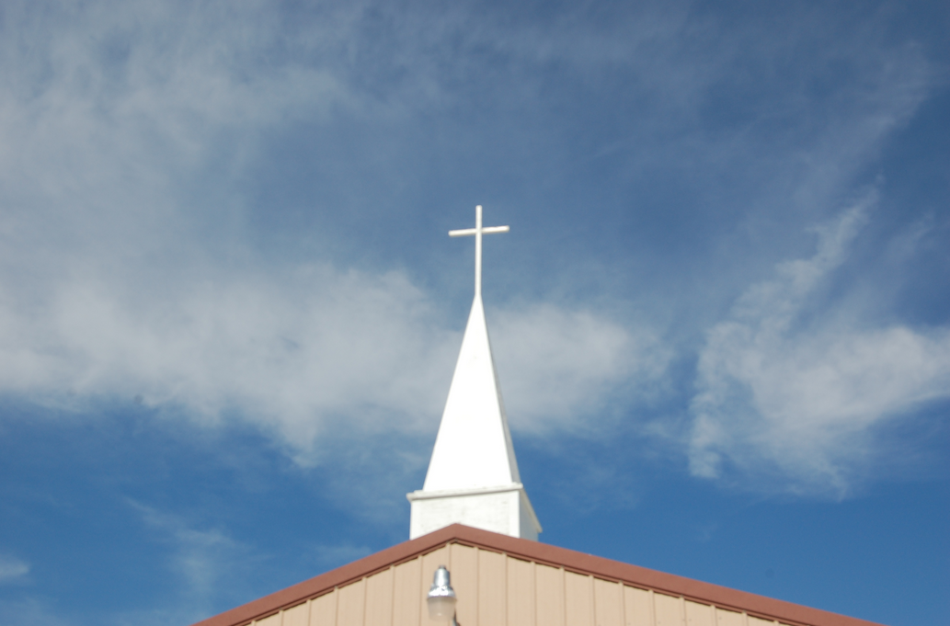
A Responsive Reading
From the First Church of Christian Jerks

Slide 2
Pastor: "Upon further reflection as a pastor in this church I must confess that from time to time I have been a jerk."
People: "Amen."

Slide 3
Pastor: "I have reacted to complaints without compassion, I have responded to ideas with defensiveness, and I have been short with people that needed me to listen."
People: "Sometimes, yes."

Slide 4
Pastor: "For all of these things and more I ask your forgiveness."
People: "You are forgiven entirely, in God's grace."

Slide 5
Pastor: "I humbly accept this forgiveness as grace because I do not deserve it, but I will seek to speak God's truth with love in the future and to stop being a jerk."

Slide 6
People: "We too believe that from time to time we have been jerks to you and to one another."
Pastor: "Amen."

Slide 7
People: "We have responded to the Word of God with criticism, we have gossiped about one another, and we have reacted to outsiders with negative words."
Pastor: "Sometimes, yes."

Slide 8
People: "For all of these things and more we ask forgiveness."
Pastor "You are forgiven entirely, in God's grace.”

Slide 9
People: “We humbly accept this forgiveness as grace because we do not deserve it, but we will seek to speak God's truth with love in the future and to stop being jerks.”

Slide 10
All: “May the God of hope fill us with all joy and peace as we trust in him, so that we may overflow with hope by the power of the Holy Spirit.”
(Romans 15:13)

Slide 11
This has been a Responsive Reading
From the First Church of Christian Jerks
© 2012 by DavidDrury.com

